Slide 1
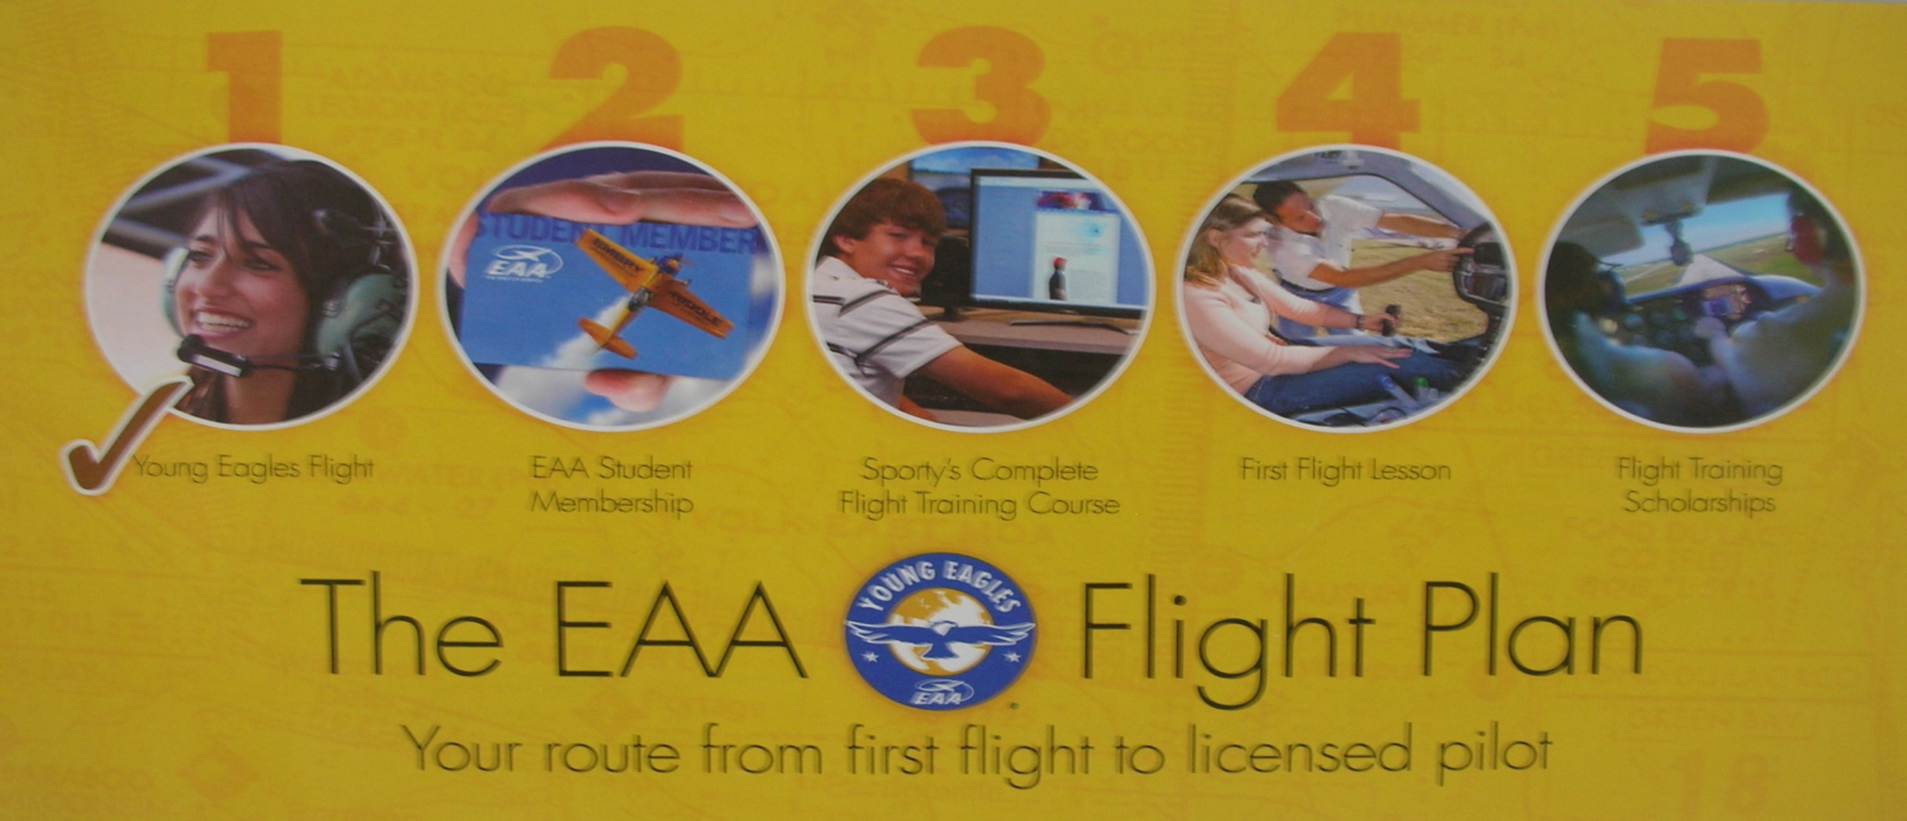
Moving from right seat to left seat
Young Eagle Flight
EAA Student Membership
Sporty’s Flight Training Course
First Flight Lesson
Flight Training Scholarships
Notes:
Logbook is important because when you take your first flight, the CFI (instructor) will enter the information in your log book.
There are a number of flight schools that participate in the First Flight Lesson program. Check the EAA website for names, locations & contact information.

Slide 2
Fourth - If you decide to become a pilot EAA will:
Reimburse the cost of FAA knowledge exam (the "Written")
Eligibility
YE between 16 and 19
Completed Sporty’s Pilot Training
Once you pass, send a copy of your results to EAA, and you will receive a check!
Notes:
EAA HQ will send you a welcome package that includes the EAA magazine, more details about the online ground school, a certificate for a free initial flight lesson (worth $150 or more!), scholarships and more!

Slide 3
Summary of YE Benefits
On-line training class =$225 (or more)
Free Flight lesson = $150 (or more)
Cost of knowledge exam =$160
Student Membership = Priceless
Total =$550+

Slide 4
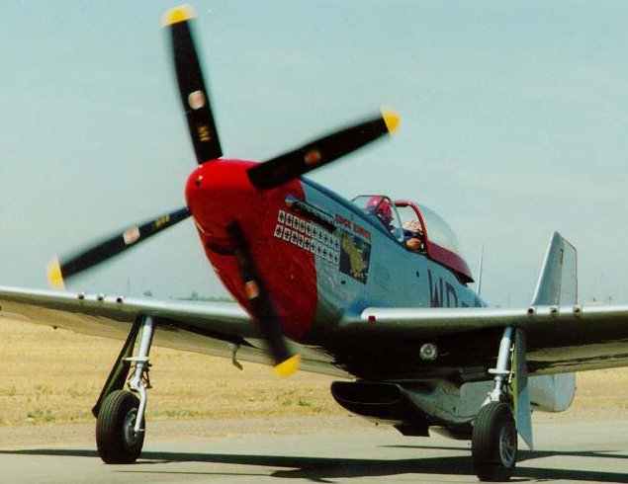
Some Safety Stuff
STAY AWAY FROM THE PROPELLER!!!
“Sterilize” the cockpit!
Listen to the Pilot! – Don’t TOUCH
Notes:
Always pay attention where you are and what's happening - situational awareness.
Our #1 Priority is to keep you safe and have fun.
You will ALWAYS be escorted once you leave the building. You will never be alone on the ramp or around an airplane.
Propellers are very dangerous and almost invisible when spinning.
Propellers, even when everything is turned off, can be dangerous
The pilot is very busy when taking off & landing. Listening to radios, looking for traffic, flying the airplane.
So Be Quiet when taking off & landing.
Want to fly? After takeoff, the pilot will ask if you want to fly.
Otherwise, do not touch anything. Do whatever the pilot tells you to do. If the pilot tells you to stick your finger in your nose, do it. Once on the ground, you can ask why your finger is in your nose.
If at any time you're not having fun or don't feel well, tell the pilot and he or she will immediately bring you back to the airport.

Slide 5
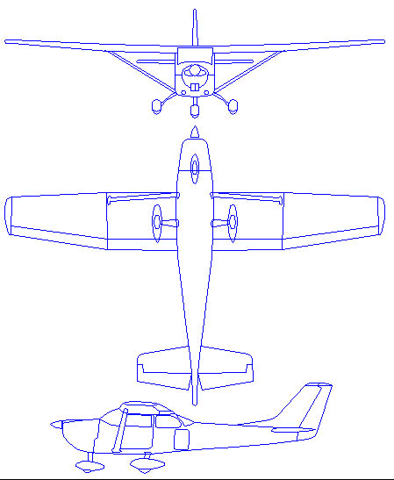
Presentation Outline
Aircraft Basics
Why Aviation/Aerospace?
A Bit of History
Aerodynamics
Control of an aircraft
Propulsion (the Engine)
Cockpit and instruments
Pilot Certificates
Airplane Safety
Fly Day!

Slide 6
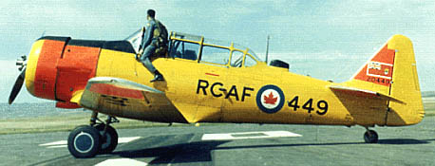
Uses of Aircraft
Examples?
Notes:
How many people here have been lost – other than the mall? If you're lost, you'll probably be found by a Civil Air Patrol airplane.
You can join CAP at age 8 and learn to fly gliders at 14.

Slide 7
Uses of Aircraft
Transportation
Cargo
Research
Sight Seeing/For Fun
Aerial Observation
Agricultural
Defense
Search and Rescue
Entertainment / Airshows
Notes:
How many people here have been lost – other than the mall? If you're lost, you'll probably be found by a Civil Air Patrol airplane.
You can join CAP at age 8 and learn to fly gliders at 14.

Slide 8
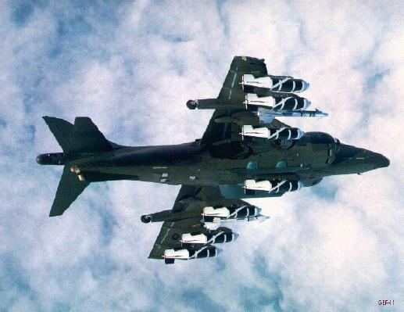
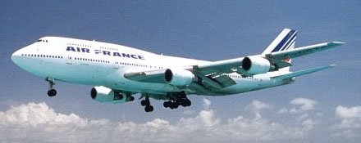
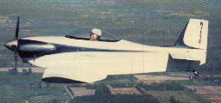
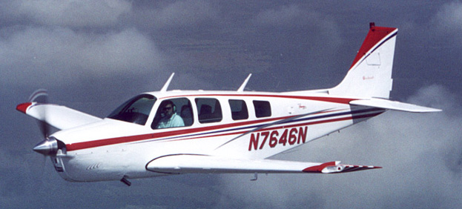
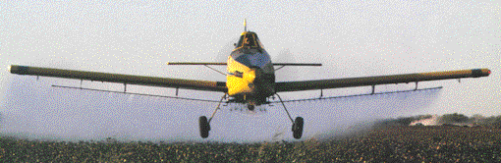
Types of Aircraft
Military
Airliner
General Aviation
Homebuilt
Agricultural
Notes:
Little spots on the 747 is a window. Park it here, and it's bigger than the building. Take the little homebuilt, we can put it in this room and walk around it.
Ag pilots – most agressive flying without being a fighter pilot – and you don't get shot at.

Slide 9
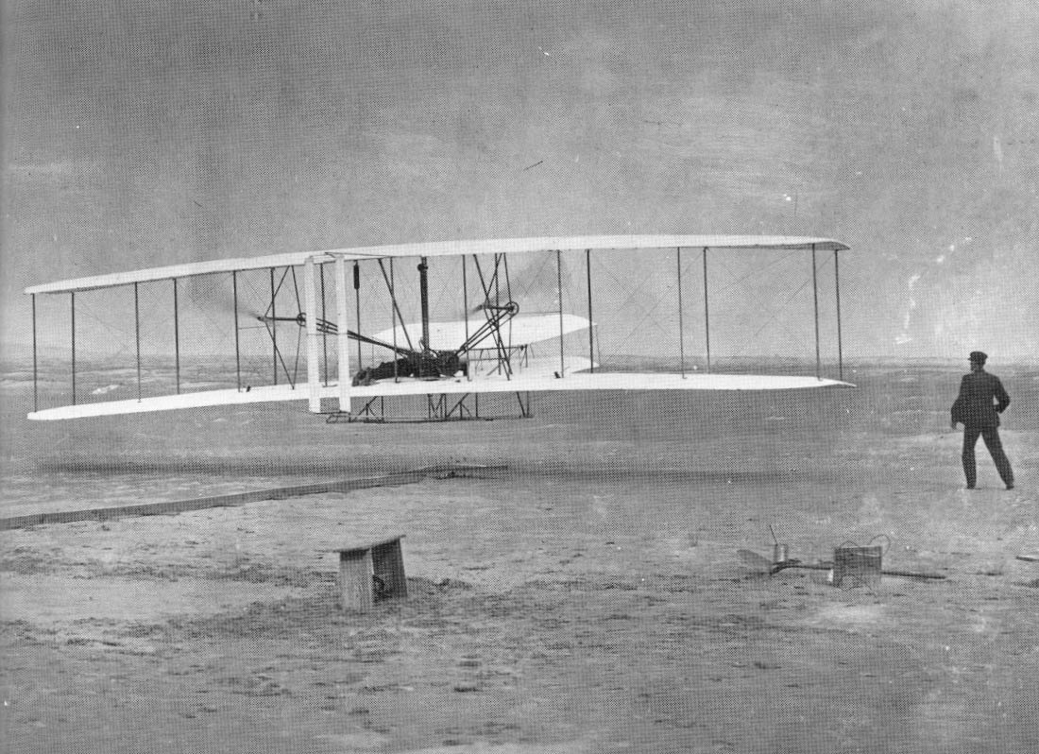
Wright 1903 Flyer
Notes:
9
Wright Brothers - high school dropouts, self-educated
Built own wind tunnels and experimented
NOT aeronautical engineers
They designed the most efficient propeller - after more than 100 years, still can't design a better prop.

Slide 10
Wright Flyer Details
1st powered flight
Pilots: Orville and Wilbur Wright
Date: 12-17-03
Flight Time = 12 seconds

